Slide 1



Internet sales dashboard
View in Power BI
Edit by Sherry Wang
Date 05/09/2023

Slide 2
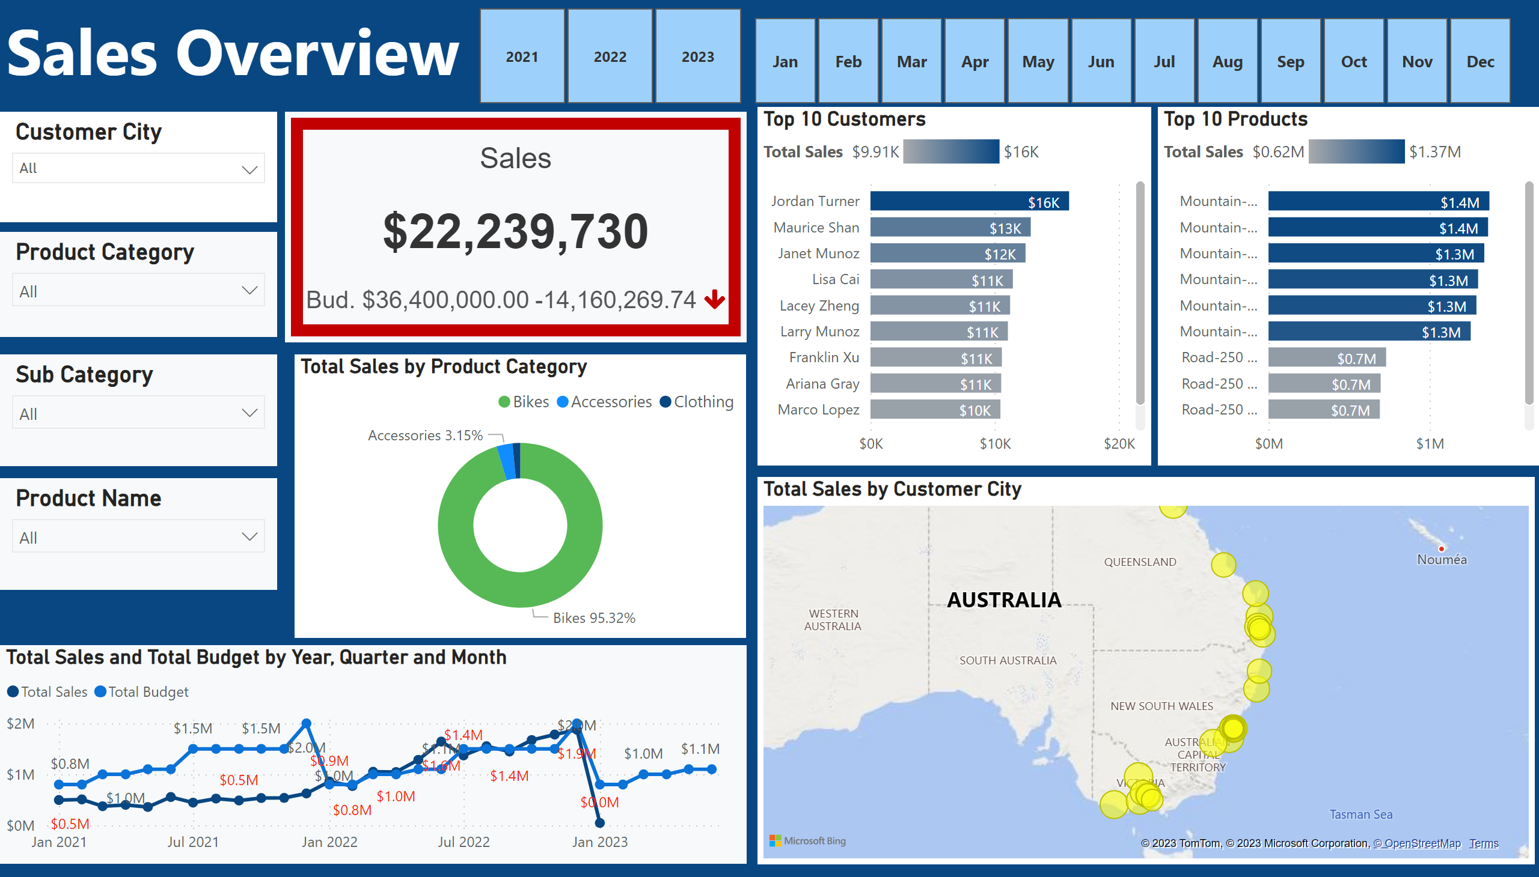
Overview Dashboard
Notes:
slicer
No alt text provided
slicer
No alt text provided
textbox
No alt text provided
slicer
No alt text provided
slicer
No alt text provided
slicer
No alt text provided
BBED0A4D4D8D44CE93CF2DAFADEE466C
No alt text provided
donutChart
No alt text provided
lineChart
No alt text provided
Top 10 Customers
No alt text provided
Top 10 Products
No alt text provided
map
No alt text provided
slicer
No alt text provided

Slide 3
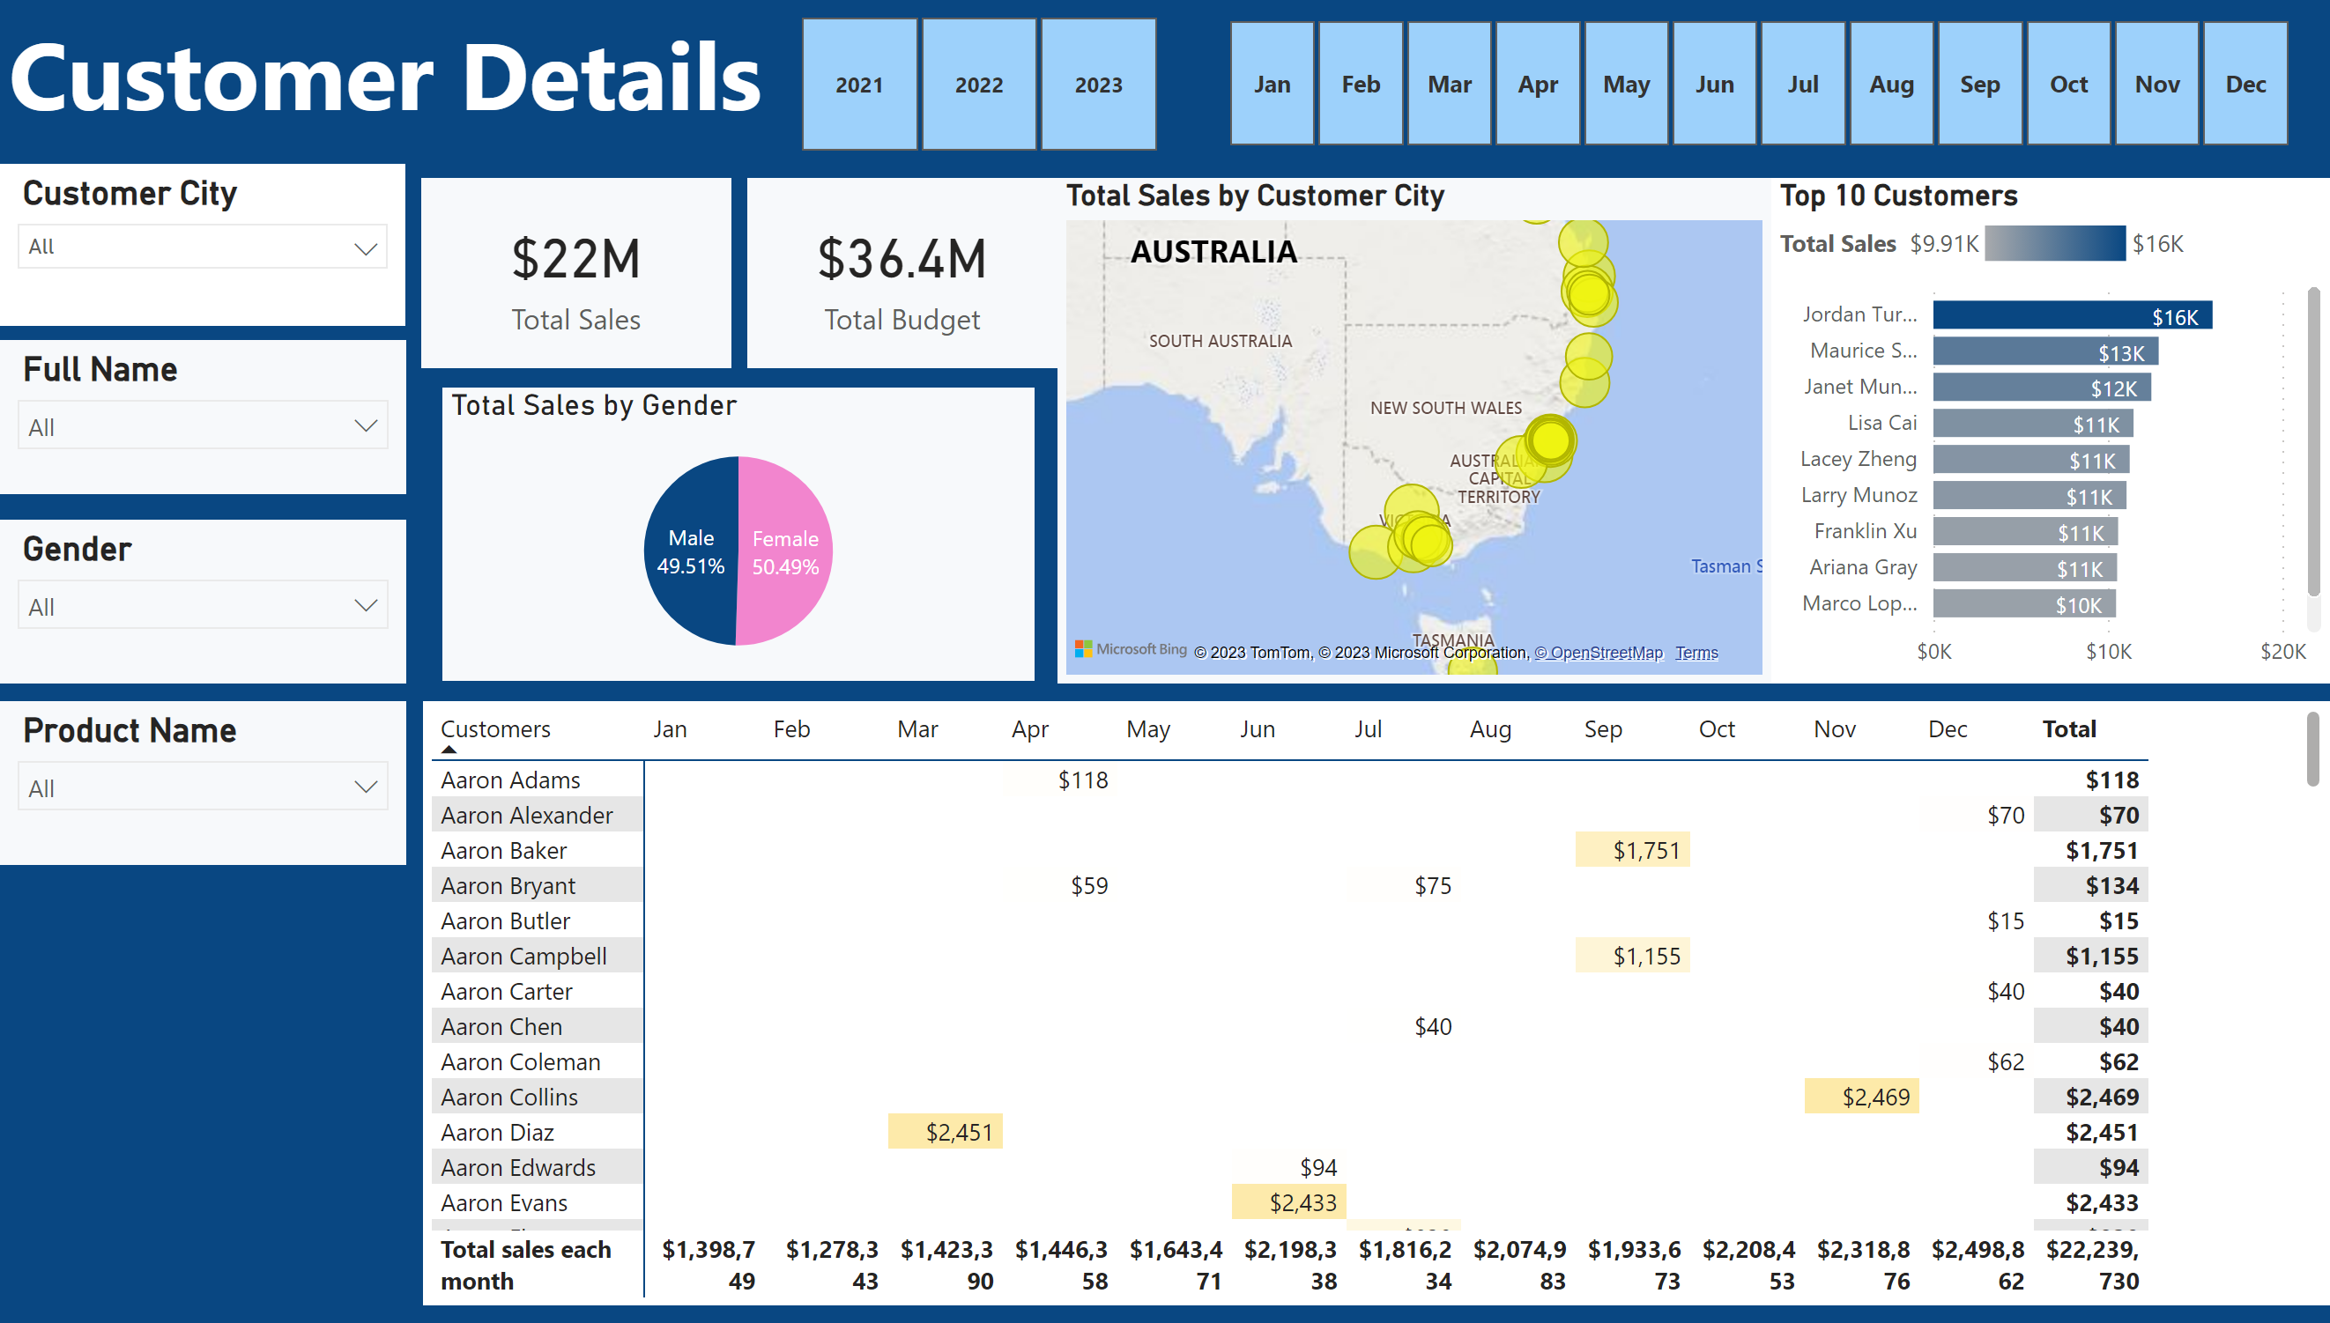
Customer Details
Notes:
slicer
No alt text provided
slicer
No alt text provided
textbox
No alt text provided
slicer
No alt text provided
slicer
No alt text provided
slicer
No alt text provided
Top 10 Customers
No alt text provided
map
No alt text provided
slicer
No alt text provided
pivotTable
No alt text provided
card
No alt text provided
card
No alt text provided
pieChart
No alt text provided

Slide 4
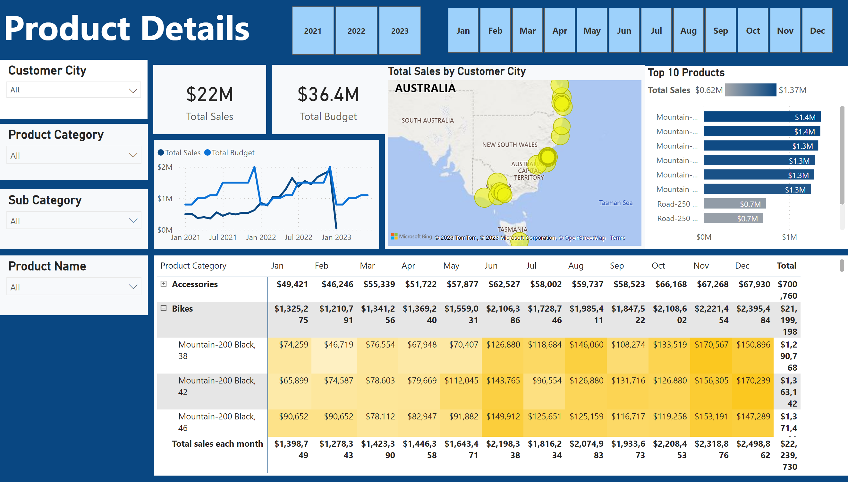
Product Details
Notes:
slicer
No alt text provided
slicer
No alt text provided
textbox
No alt text provided
slicer
No alt text provided
slicer
No alt text provided
slicer
No alt text provided
lineChart
No alt text provided
map
No alt text provided
slicer
No alt text provided
pivotTable
No alt text provided
card
No alt text provided
card
No alt text provided
Top 10 Products
No alt text provided

Slide 5
introduction
In response to a critical business request, our team is transitioning from static sales reports to a dynamic visual dashboard. This initiative aims to provide comprehensive insights into product sales, customer relationships, and historical trends while enabling customized views for the sales team and facilitating performance benchmarking for the future.

Slide 6
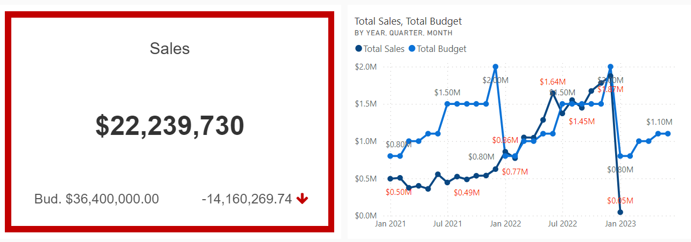
Sales comparing with budget from 2021 to 2023
Actual Sales consistently exceeded budgeted amounts in 2021 and 2022, indicating business growth during this period, but incomplete data for the early months of 2023 hinders an assessment of the sales trend for that year.
The budgeted amounts for total sales have shown periodic adjustments over the three years, ranging from $800,000 in 2021 to $1,500,000 in 2022, possibly reflecting changing business expectations or goals.
the sales trend analysis highlights the need for the company to address consistent underperformance compared to the budget in 2021 and 2022

Slide 7
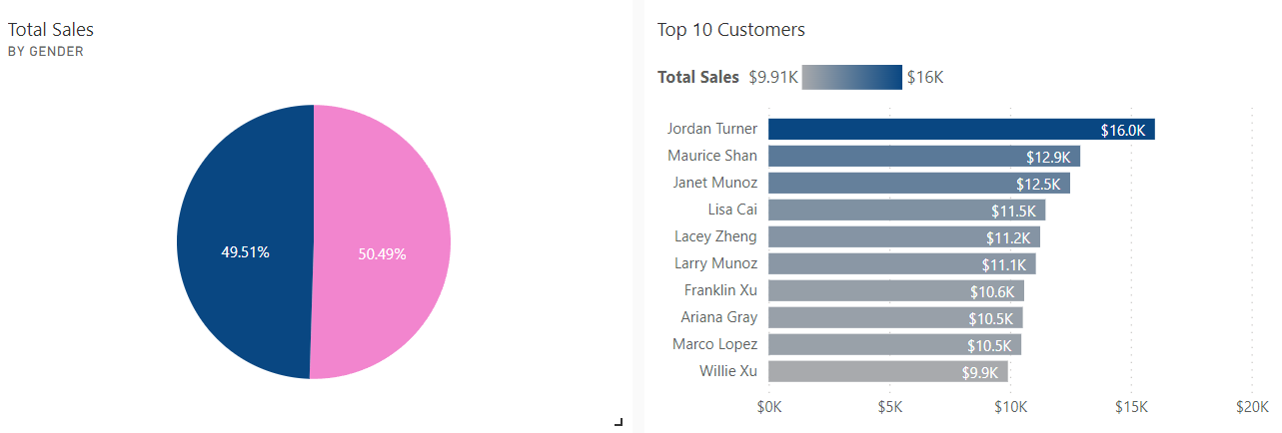
Customer details related to Sales
Female and male customers share nearly half amount of sales, but females generated slightly higher sales revenue compared to males.
Top 10 Customer in past two years: Jordan Turner spend $16k who rank in the first.

Slide 8
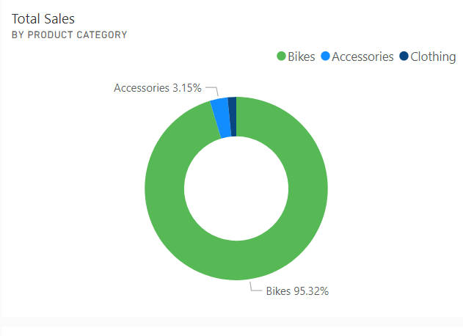
Product details related to Sales

Slide 9
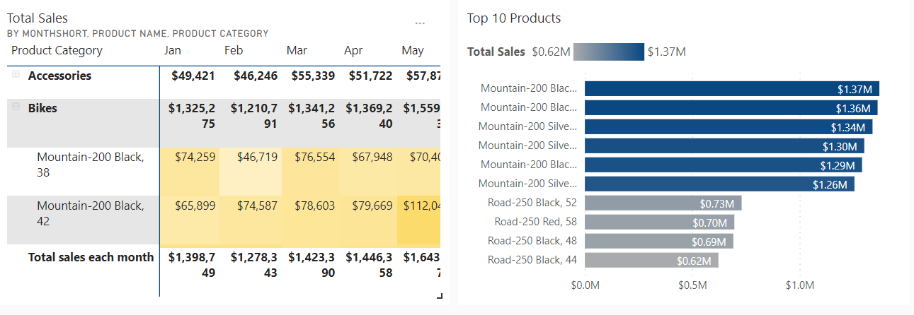
Top 10 Product sales
The top-selling product in the dataset appears to be "Mountain-200 Black, 38" under the "Bikes" category, with significantly higher sales than other products.

Slide 10
Limitation and suggestion
In 2023, the data is incomplete, with no actual sales figures available for the first few months, making it difficult to assess the trend for that year. To make informed decisions and set realistic budgets for 2023, the company needs to gather and analyse data for the entire year.
Moreover, without time limitation, the data modelling can be more specific to analyse sales of product related to customer city, to identify which city or country contribute most sales in the past 2 years.

Slide 11
Conclusion
In summary, the analysis indicates a period of substantial business growth in 2021 and 2022, with actual sales consistently surpassing budgeted amounts. The fluctuations in budgeted figures over these years suggest an adaptable approach to changing business expectations. The need to address underperformance, particularly in comparison to the budget, is evident, along with an opportunity to nurture top-performing customers and focus on the top-selling product, "Mountain-200 Black, 38," in the "Bikes" category for strategic emphasis.

Slide 12
Reference
Data from
https://learn.microsoft.com/en-us/sql/samples/adventureworks-install-configure?view=sql-server-ver16&tabs=ssms

